Slide 1
DATA VISUALIZATION
Turning Order Data into Boardroom-Ready Insights
Project 4 • DecodeLabs Industrial Training Kit • Batch 2026

Slide 2
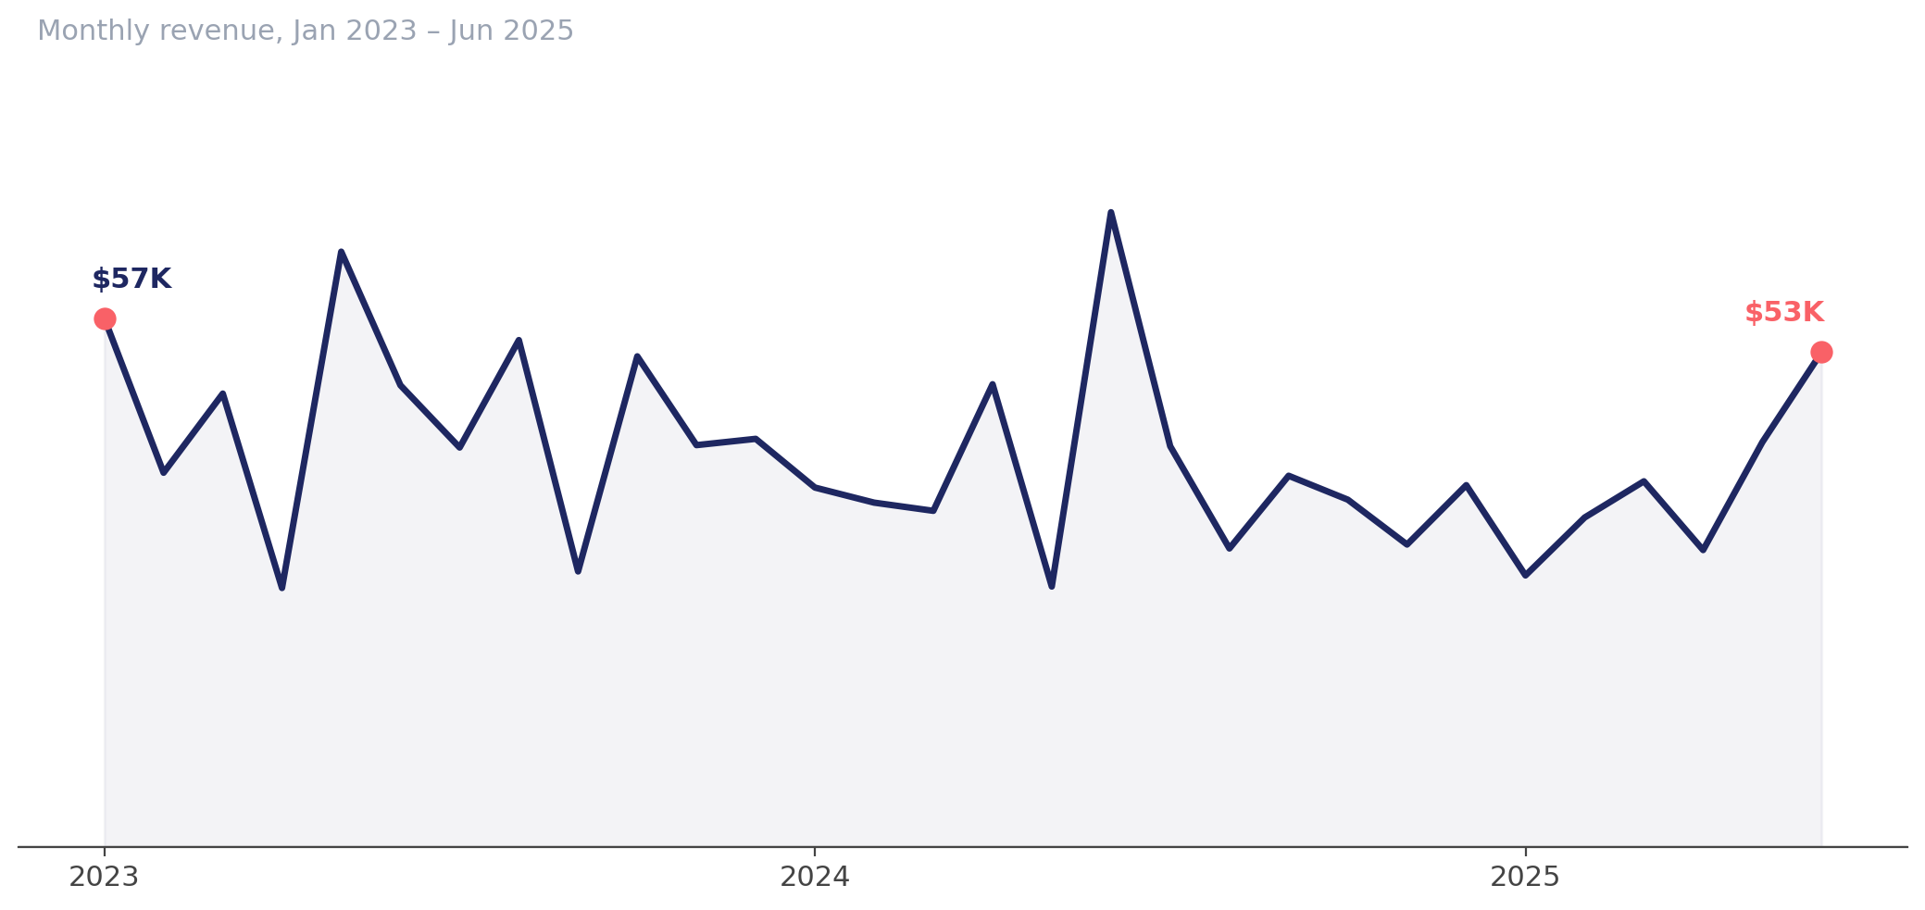
Average monthly revenue has slipped 16% since 2023
So what: monthly revenue averaged $46.1K in 2023 vs. $38.6K in the first half of 2025 — investigate demand or fulfillment issues before planning next year's targets.

Slide 3
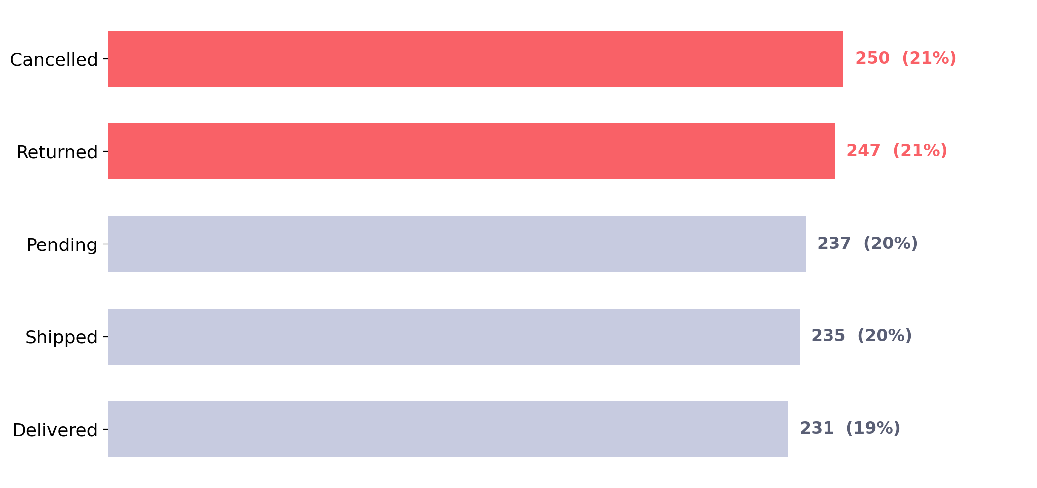
41% of orders end in cancellation or return, risking $520K
So what: Cancelled and Returned orders together account for 497 of 1,200 orders and $519.7K of gross revenue — tightening checkout and post-purchase follow-up should be the top operational priority.

Slide 4
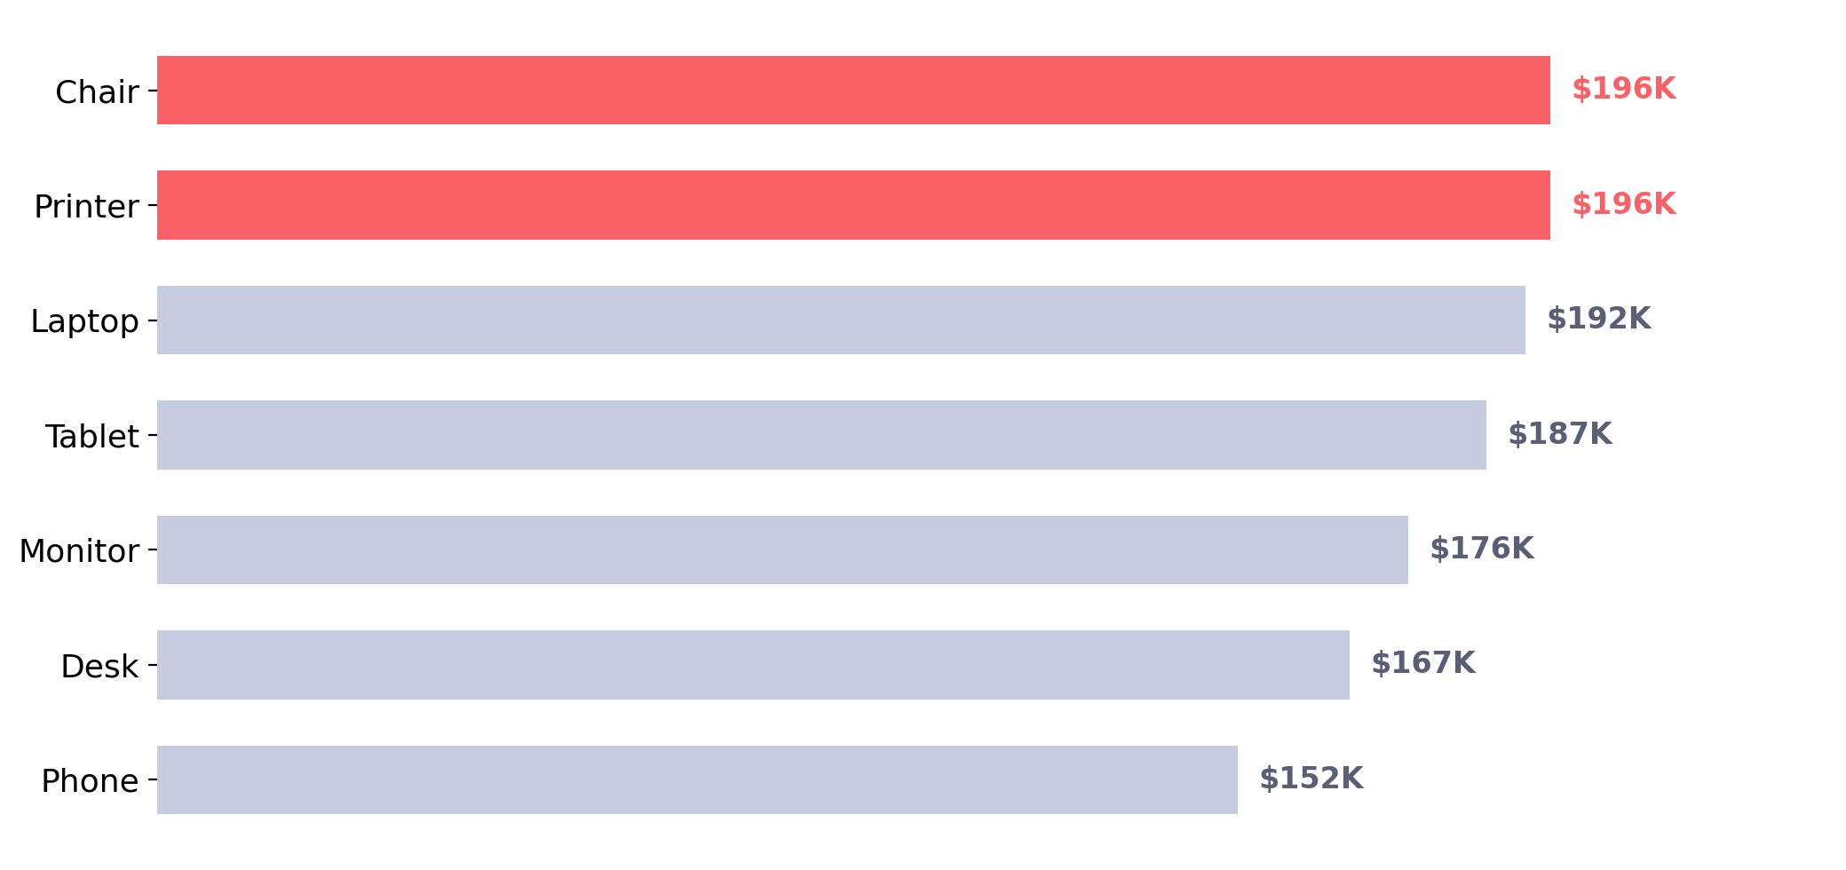
Chairs and Printers lead revenue; Phones trail 22% behind
So what: Chairs ($195.6K) and Printers ($195.6K) are the top two products by revenue, while Phones ($151.7K) generate 22% less — review Phone pricing and promotion before the next assortment review.

Slide 5
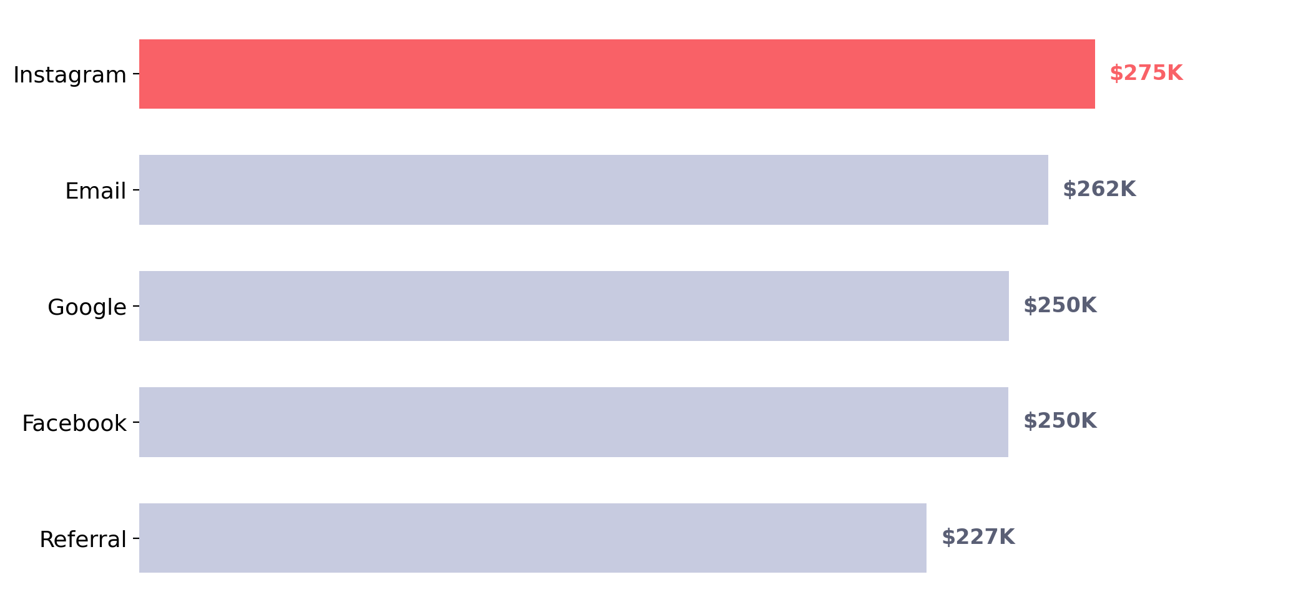
Instagram referrals generate the most revenue of any channel
So what: Instagram drove $275.3K of revenue, 21% more than direct Referral links ($226.8K) — shifting marketing budget toward Instagram is the highest-leverage channel move available.

Slide 6
Recommendation
Fix fulfillment first, then double down on Instagram and top-selling products
SITUATION
COMPLICATION
RESOLUTION
Revenue is healthy at ~$1.26M across 1,200 orders, but average monthly revenue has drifted down 16% since 2023.
41% of all orders are Cancelled or Returned — $519.7K in gross revenue never truly converts, and this is the single largest drag on the top line.
Audit checkout and post-purchase experience to cut cancellations, then reinvest the savings into Instagram acquisition and Chair/Printer inventory, the strongest revenue drivers.
DecodeLabs • Project 4: Data Visualization • Batch 2026

